Slide 1
IBM Carbon TreeView
Overview
Tree View … First View (Static TreeView)
Dynamic TreeView
Approaches to provide TreeData dynamically
Fundamentals of Graph Theory
Server Sided Java-Frameworks to handle Graphs
JGraphT

Slide 2

IBM Carbon TreeView
Overview
Tree View … First View (Static TreeView)
Dynamic TreeView
Approaches to provide TreeData dynamically
Fundamentals of Graph Theory
Server Sided Java-Frameworks to handle Graphs
JGraphT
Notes:
Dieses Thema findet man in der Carbon Dokumentation

Slide 3
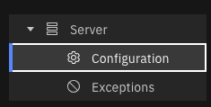
Static TreeView
import React, { Component } from 'react';
import { TreeView, TreeNode } from '@carbon/react';
import { BareMetalServer, Settings, Error } from '@carbon/icons-react’;
render() {
. . .
<TreeView
label=""
onSelect={() => { }}
> <TreeNode
id="1"
label="Server"
value=""
isExpanded={true}
renderIcon={BareMetalServer}>
<TreeNode
id="1-1"
label="Configuration"
value=""
renderIcon={Settings}
onSelect={this.toggleUi.bind(this, 'config’)}
/>
<TreeNode
id="1-2"
label="Exceptions"
value=""
renderIcon={Error}
onSelect={this.toggleUi.bind(this, 'exceptions’)}
/>
</TreeNode>
</TreeView>

Slide 4
IBM Carbon TreeView
Overview
Tree View … First View (Static TreeView)
Dynamic TreeView
Approaches to provide TreeData dynamically
Fundamentals of Graph Theory
Server Sided Java-Frameworks to handle Graphs
JGraphT

Slide 5
Dynamic TreeView
Reasons for Dynamic
Data displayed in the TreeView is not known at the time of UI programming but is provided externally (e.g. via REST-Endpoint).
The following illustration shows various tree structure – typical examples:
Company Organization
Hierarchical bill of materials for a product (similar to an exploded view)
Directory Tree (directories, subdirectories, files)

Slide 6
IBM Carbon‘s TreeView - A look ahead to dynamic behavior
The TreeView expects the following data structure
… this can be populated via JSON in an easy way:
type TypeTreeNode = {
id: string;
label: string;
children?: TreeNode[];
};
type TypeTreeNodeList = TypeTreeNode[]
function captureTreeContentExample()
{
let data = [
{
id: "1",
label: "First Node",
children: [
{ id: "1-1", label: "Child 1"},
{ id: "1-2", label: "Child 2"},
], },
{
id: "2",
label: "Second Node",
},
];
return data;
}
Dilemma:
It is not the task of a backend implementation (e.g. REST endpoint) to meet all the specific requirements of a front end.
There may be many front ends on different end devices with different requirements.

Slide 7

IBM Carbon‘s TreeView - A look ahead to dynamic behavior
Take a look at the example:

Slide 8
IBM Carbon TreeView
Overview
Tree View … First View (Static TreeView)
Dynamic TreeView
Approaches to provide TreeData dynamically
Fundamentals of Graph Theory
Server Sided Java-Frameworks to handle Graphs
JGraphT

Slide 9

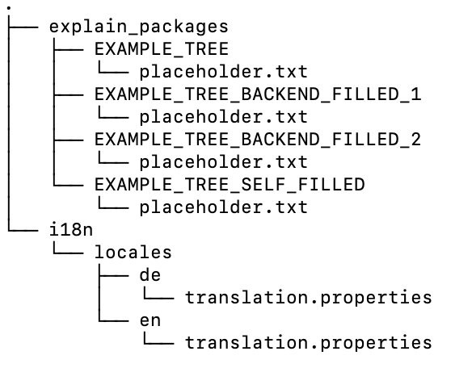
Dynamic Tree-Data – Approach 1: Tree-Data is per default a Tree
Example: Directory Tree

Slide 10

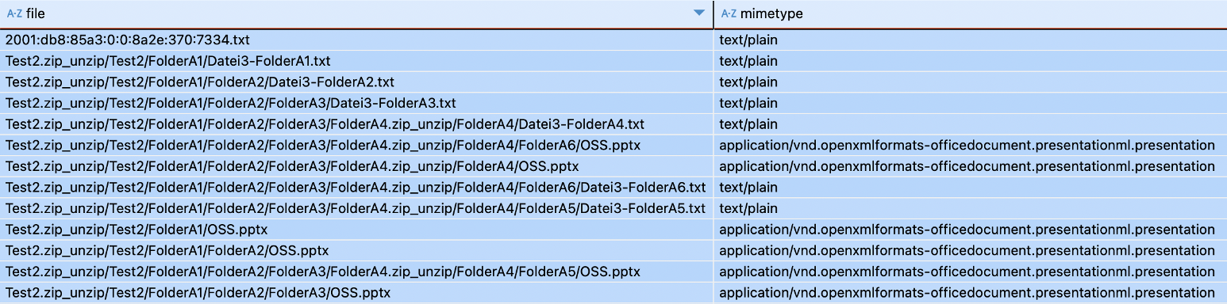
Dynamic Tree-Data – Approach 2: Tree-Data is List with hierarchical Information
Example: Content of a relational Database

Slide 11
Dynamic Tree-Data – Approaches
Approach 1
REST-Client (Java Script)
REST-Endpoint (Java ) delivers Tree (direct)
Approach 2
REST-Client (Java Script)
REST-Endpoint (Java ) delivers Tree
Transformer (Java)
Java reads Source: List
with Hierarchy – Information *1
Other
Approach
Transformer (JavaScript)
REST-Client (Java Script)
REST-Endpoint delivers List
with Hierarchy – Information *1
Notes:
Q: Why is the other Approach not discussed in detail
A: There might be Java-Sources on the Backend, which are also interested in Trees. Therefore Tree-Transformation makes sense to performed in Backend

Slide 12
IBM Carbon TreeView
Overview
Tree View … First View (Static TreeView)
Dynamic TreeView
Approaches to provide TreeData dynamically
Fundamentals of Graph Theory
Server Sided Java-Frameworks to handle Graphs
JGraphT

Slide 13
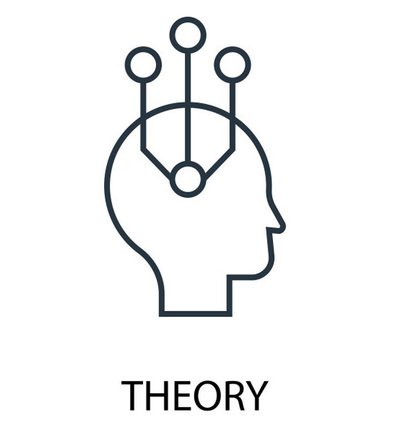
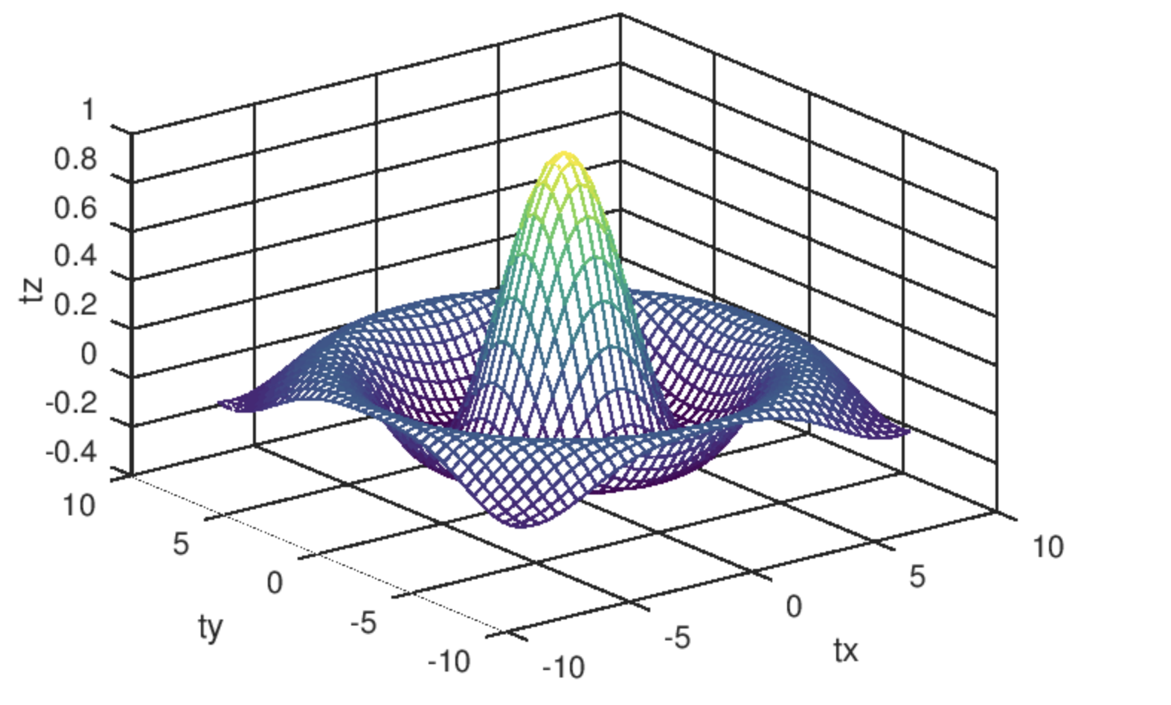

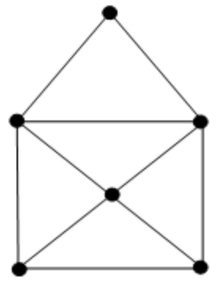
What is a Graph
Any object consisting of Nodes and connections (= Edges)

Slide 14
How to understand a Tree as Graph
1
2
3
4
5
6
7
8
Node with an ID
n
Edge

Slide 15
A Tree is a directed Graph
1
2
3
4
5
6
7
8
A directed Edge
2
1
… points from one Node (2) to another Node (1)
… ParentID of (2) is (1)

Slide 16
A Node within a Tree can have Children[]
1
children[] :
1
children[] :
2
3
2
3
2
children[] :
4
5
3
6
7
8
4
5
6
7
8

Slide 17
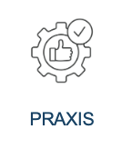
Typically a Node within a Tree represents Objects of normal Life
1
Company
2
Department
3
Department
4
5
6
7
8
Person
Person
Person
Person
Person
What helpes: Each Objekt is defined by Attributes (we say: Payload)
Company
Department
Person
Name
Type of Company
Headquarter
…
Name
Task
…
Name
Firstname
Date of Birth,
…

Slide 18
A Tree as Graph - Summary
Directed Graph
1
2
3

Slide 19
A Tree as Graph – Helpful Attributes
1
id | parentId
1
Payload
children[2]
2,3
2
3
id | parentId
2 | 1
Payload
id | parentId
3 | 1
Payload
children[0]
---
children[0]
---

Slide 20
IBM Carbon TreeView
Overview
Tree View … First View (Static TreeView)
Dynamic TreeView
Approaches to provide TreeData dynamically
Fundamentals of Graph Theory
Server Sided Java-Frameworks to handle Graphs
JGraphT

Slide 21
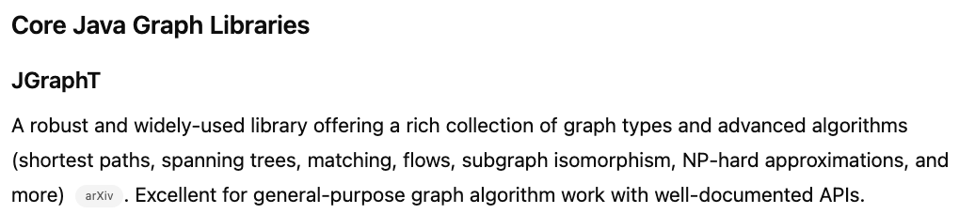
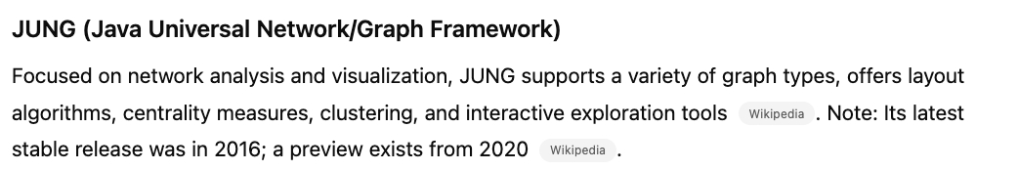
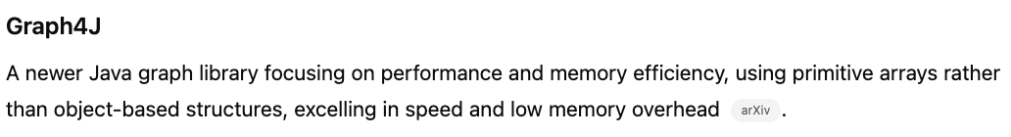
Available Java-Framworks to hande Graphs
ChatGPT:
Important @ IBM: Licenses
EPL 2.0
Allowed
LGPL 2.1
Allowed (under particular circumstances)
BSD v???
Some Versions of BSD-License are denied
GPL
Denied in any version
…

Slide 22
Selected: JGraphT
Is established in the market (actively maintained and frequently used)
Helps on particular Topics, to avoid a lot of manual work
Avoid Loops in Trees
Avoid unclean trees (e.g., 1 node with multiple parents)
No License Issues
Is flexible to handle own Java Data Structure
=> Therefor: JGraphT was selected

Slide 23
IBM Carbon TreeView
Overview
Tree View … First View (Static TreeView)
Dynamic TreeView
Approaches to provide TreeData dynamically
Fundamentals of Graph Theory
Server Sided Java-Frameworks to handle Graphs
JGraphT (Results asking ChatGPT)

Slide 24
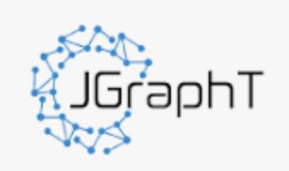
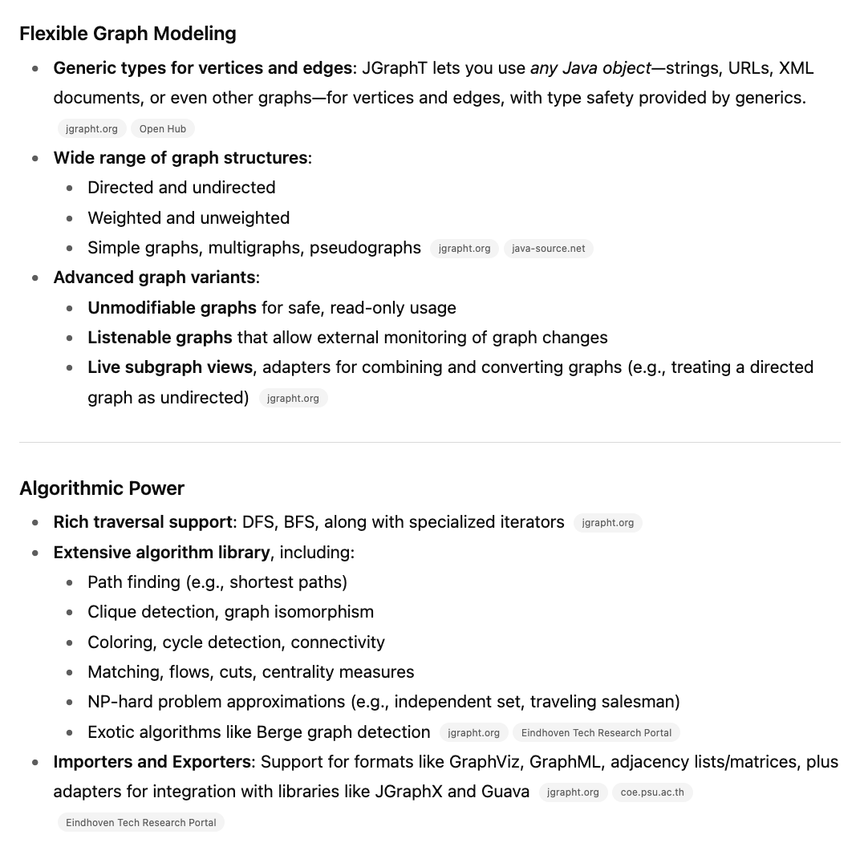
General Features of JGraphT – a ‚short‘ Overview provided by ChatPGPT

Slide 25
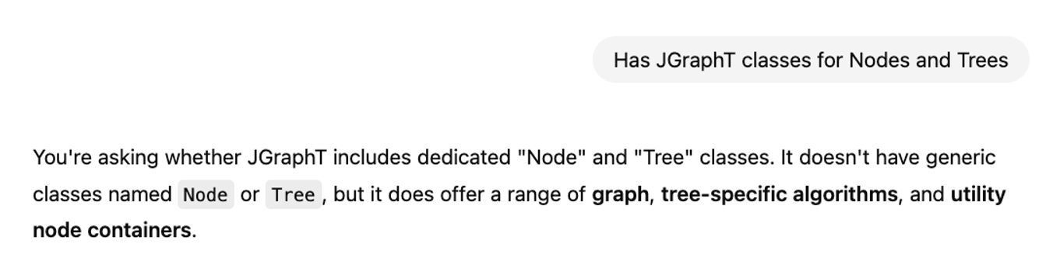
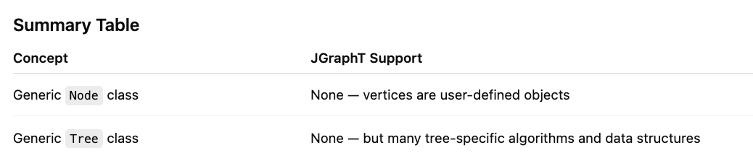
More prompting in ChatGPT about JGraphT
. . .
JGraphT‘s Vocabulary:
Vertex & Edge

Slide 26
JGraphT – Example for an Undirected Graph
import org.jgrapht.*;
import org.jgrapht.graph.*;
public class ExampleUndirectedGraph {
public static void main(String[] args) {
Graph<String, DefaultEdge> g = new SimpleGraph<>(DefaultEdge.class);
g.addVertex("A");
g.addVertex("B");
g.addVertex("C");
g.addEdge("A", "B");
g.addEdge("B", "C");
g.addEdge("C", "A");
System.out.println(g);
}
}
JGraphT‘s Vocabulary:
Vertex & Edge

Slide 27
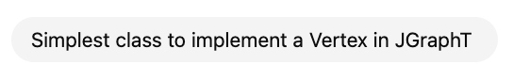
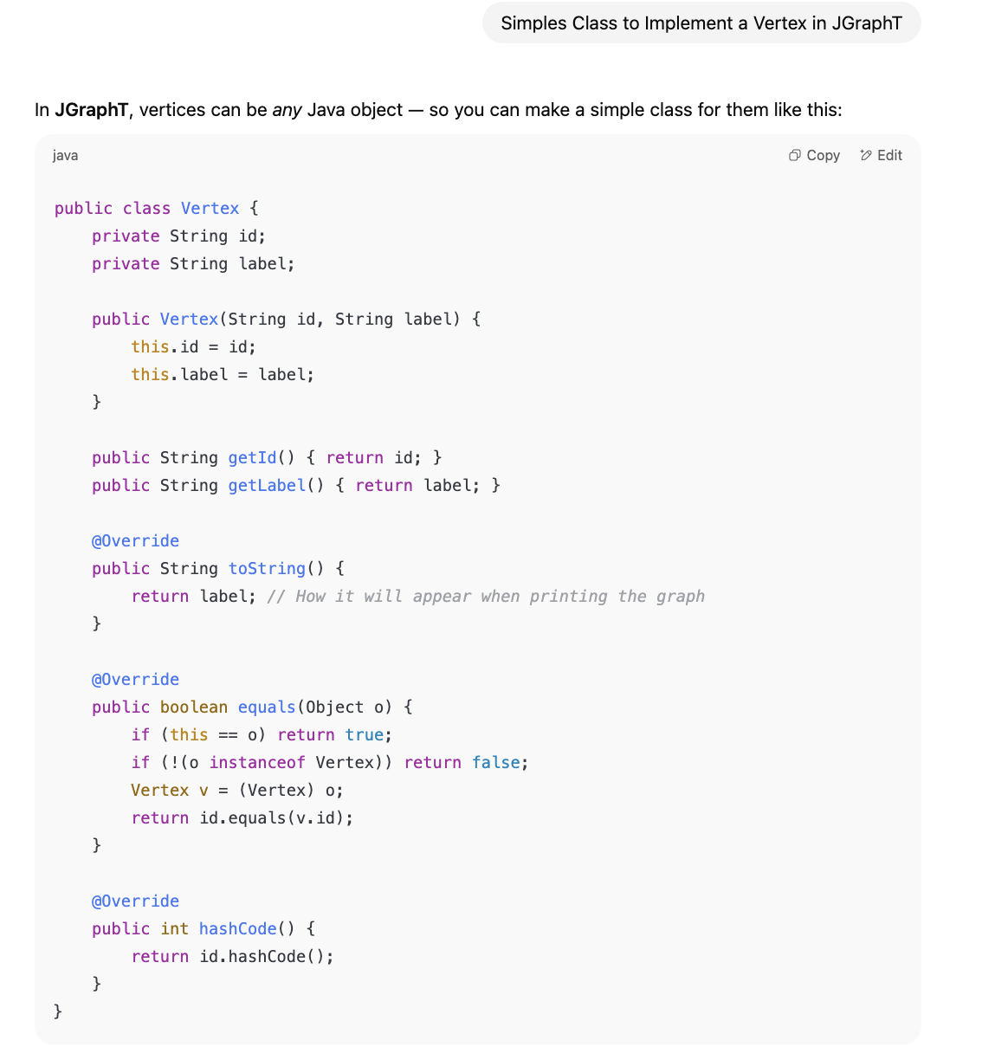
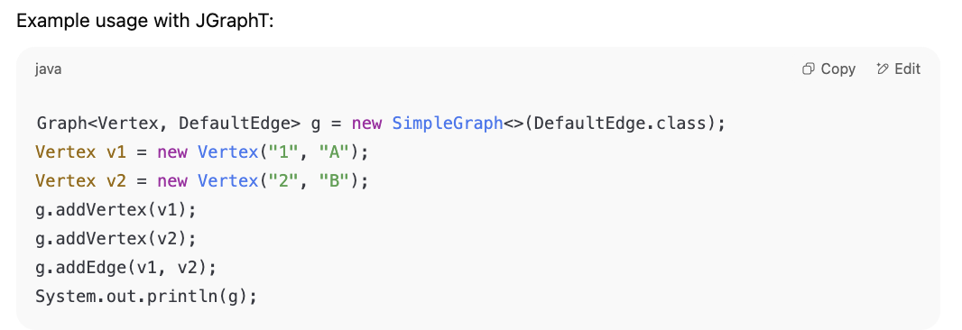
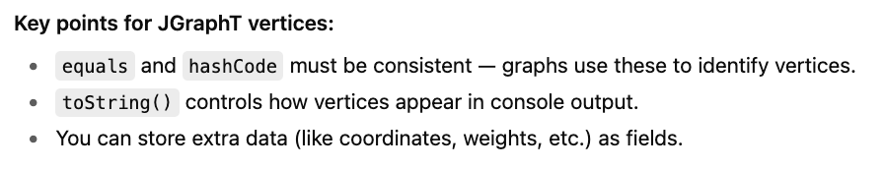
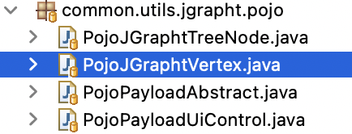
You will see this in our Example Packages:

Slide 28
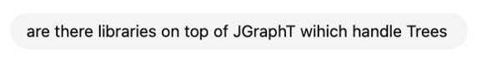
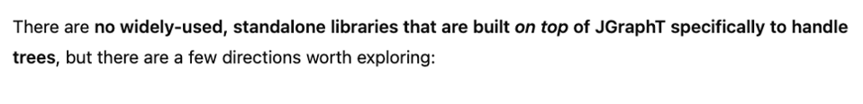
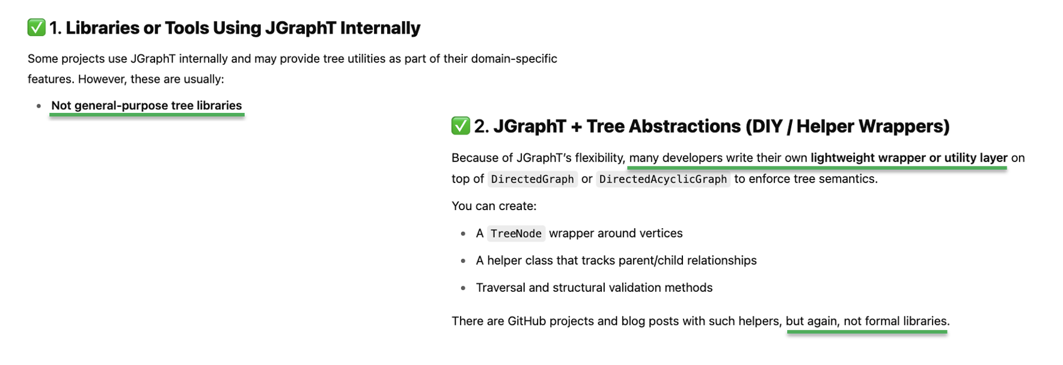
We do so in our Example Packages

Slide 29
Remember: Our Approaches
Approach 1
REST-Client (Java Script)
REST-Endpoint (Java ) delivers Tree (direct)
Approach 2
REST-Client (Java Script)
REST-Endpoint (Java ) delivers Tree
Transformer (Java)
Java reads Source: List
with Hierarchy – Information
Technical Requirement: Consistency of Result (independent from Approach)

Slide 30
Central Object
Vertex
id | parentId
“” | “”
Payload
children[0]
UiControl
Types of PayLoad
Name
Type of Company
Headquarter
…
Name
Task
…
Name
Firstname
Date of Birth,
…
UiControl
visible
expanded
…

Slide 31
IBM Carbon TreeView
Approach 1
REST-Client (Java Script)
REST-Endpoint (Java ) delivers Tree (direct)

Slide 32
Approach 1: Recursion
Root Vertex
// Handle Root
id | parentId
“” | “”
Payload
children[0]
UiControl

Slide 33
Approach 1: Recursion
Root Vertex
id | parentId
“” | “”
Payload
children[0]
UiControl
// Handle Child
Child Vertex
id | parentId
“Lindemann.txt” | “”
Payload
children[]
UiControl

Slide 34
Approach 1: Recursion
Root Vertex
id | parentId
“” | “”
Payload
children[0]
UiControl
// Hierarchy
Handling
Child Vertex
id | parentId
“Lindemann.txt” | “”
Payload
children[]
UiControl

Slide 35
Approach 1: Recursion
Root Vertex
id | parentId
“” | “”
Payload
children[0]
UiControl
Edge (Child => Parent)
// Hierarchy
Handling
Child Vertex
id | parentId
“Lindemann.txt” | “”
Payload
children[]
UiControl

Slide 36
Approach 1: Recursion
Root Vertex
id | parentId
“” | “”
Payload
children[0]
UiControl
// Hierarchy
Handling
Child Vertex
id | parentId
“Lindemann.txt” | “”
Payload
children[]
UiControl

Slide 37
Approach 1: Recursion
Root Vertex
id | parentId
“” | “”
Payload
children[1]
UiControl
// Hierarchy
Handling
Child Vertex
id | parentId
“Lindemann.txt” | “”
Payload
children[]
UiControl

Slide 38
IBM Carbon TreeView
Approach 2
REST-Client (Java Script)
REST-Endpoint (Java ) delivers Tree
Transformer (Java)
Java reads Source: List
with Hierarchy – Information

Slide 39
Approach 2: List with hierarchical information
“1” “First Root Node”
Java reads Source: List
with Hierarchy – Information
“2” “Second Root Knoten”
“3” “1st Child of Node A”, “1”
“4” “2nd Child of Node B”, “1”
id
label
parentId

Slide 40
Approach 2: List with hierarchical information
id | parentId
“1” | “”
1
Payload
id | parentId
“2” | “”
2
Payload
children[0]
UiControl
children[0]
UiControl
id | parentId
“3” | “1”
3
Payload
id | parentId
“4” | “1”
4
Payload
children[0]
UiControl
children[0]
UiControl

Slide 41
Approach 2: List with hierarchical information
Root Vertex
Root Vertex
id | parentId
“1” | “”
1
Payload
id | parentId
“2” | “”
2
Payload
children[0]
UiControl
children[0]
UiControl
Child Vertex
Child Vertex
id | parentId
“3” | “1”
3
Payload
id | parentId
“4” | “1”
4
Payload
children[0]
UiControl
children[0]
UiControl

Slide 42
Approach 2: List with hierarchical information
Root Vertex
Root Vertex
id | parentId
“1” | “”
1
Payload
id | parentId
“2” | “”
2
Payload
children[0]
3,4
UiControl
children[0]
UiControl
Child Vertex
Child Vertex
id | parentId
“3” | “1”
3
Payload
id | parentId
“4” | “1”
4
Payload
children[0]
UiControl
children[0]
UiControl

Slide 43
Approach 1 and 2 provide the same consistent Data Structure
Root Vertex
id | parentId
“” | “”
Payload
children[1]
UiControl
Edge
// Hierarchy
Handling
Child Vertex
id | parentId
“Lindemann.txt” | “”
Payload
children[]
UiControl

Slide 44
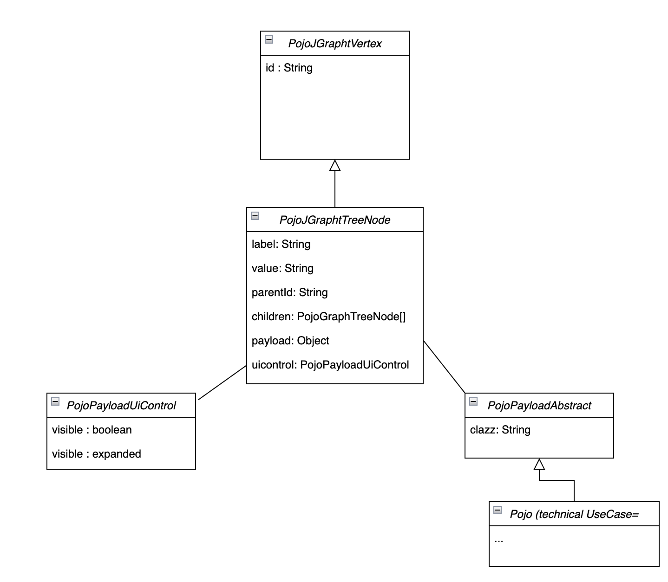
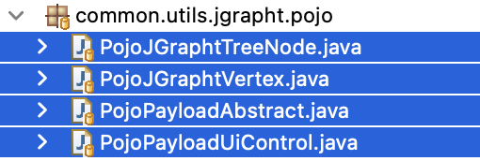
Pojo: Data to deal with and to hand over to IBM Carbon Client
Common
Pojo = Plain Old Java Object
Attributes
Getter & Setter
Technical Use Case
Notes:
Here: Show one of Example Endpoints in Swagger

Slide 45
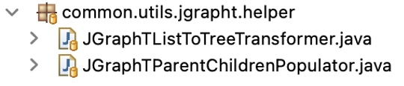
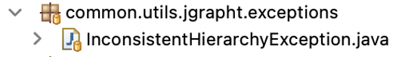
Pojo: Data to deal with and to hand over to IBM Carbon Client
1
1
Performs this Job in Approach 2:
2
REST-Endpoint (Java ) delivers Tree
3
Transformer (Java)
can throw
3
SimpleDirectedGraph
Java reads Source: List
with Hierarchy – Information
2
Supports unique Data Structure in Approach 1
REST-Endpoint (Java ) delivers Tree (direct)
Notes:
Here: Show one of Example Endpoints in Swagger

Slide 46
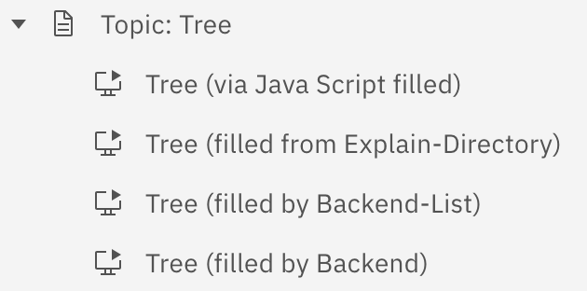
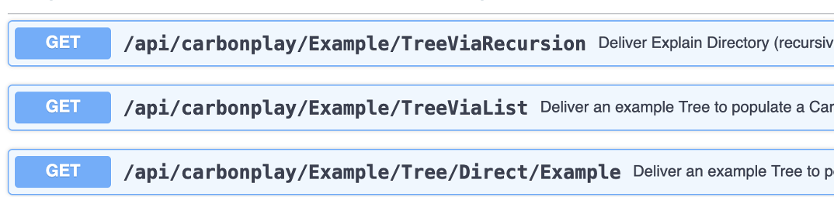
Overview about the Examples:
Implementation without Server & Endpoints

Slide 47
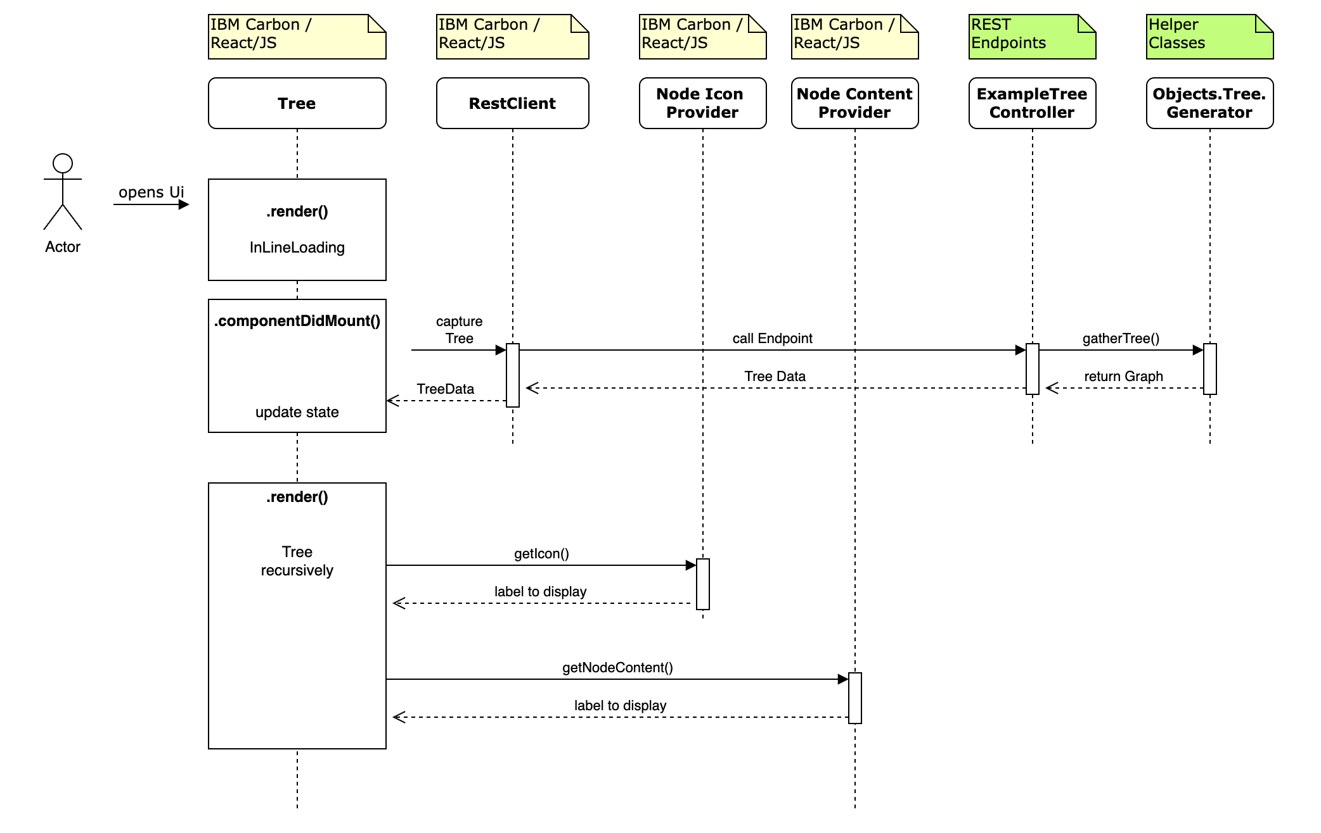
The Basic Sequence Diagram
All Examples follow this Sequence Diagram
… more or less with
Variations

